Slide 1
Algorithm Analysis and Design Advanced Data Structure (Red Black Tree) (Deletion)
Lecture -30-32

Slide 2
Overview
A variation of binary search trees.
Balanced: height is O(lg n), where n is the number of nodes.
Operations will take O(lg n) time in the worst case.

Slide 3
Red Black Tree (Deletion)
Start by doing regular binary-search-tree deletion:

Slide 4
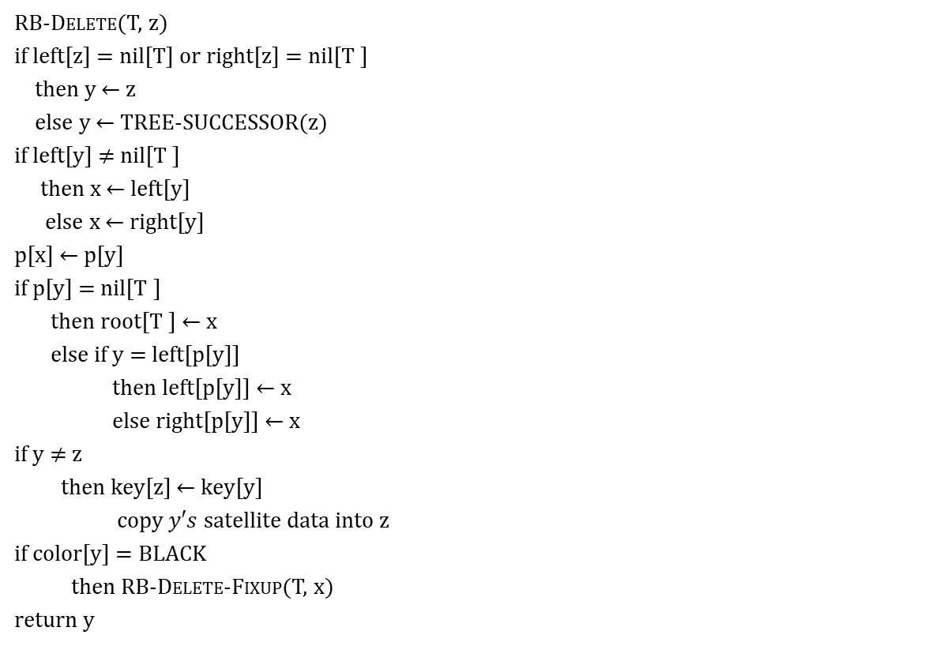
Red Black Tree (Deletion)
RB-Delete(T, z)
if left[z] = nil[T] or right[z] = nil[T ]
then y ← z
else y ← TREE-SUCCESSOR(z)
if left[y] $≠$ nil[T ]
then x ← left[y]
else x ← right[y]
p[x] ← p[y]
if p[y] = nil[T ]
then root[T ] ← x
else if y = left[p[y]]
then left[p[y]] ← x
else right[p[y]] ← x
if y $≠$ z
then key[z] ← key[y]
copy $y′s$satellite data into z
if color[y] = BLACK
then RB-Delete-Fixup(T, x)
return y

Slide 5

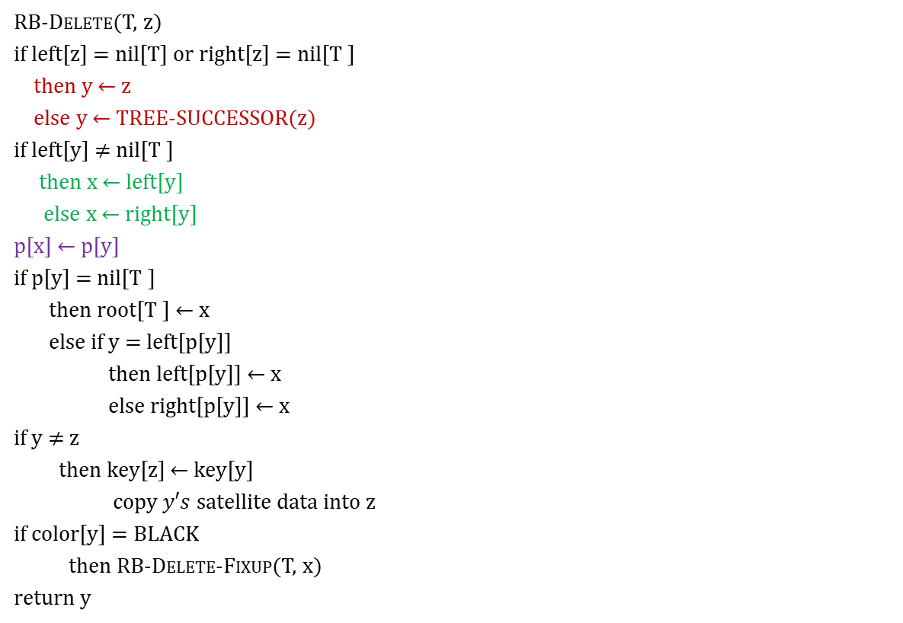
Red Black Tree (Deletion)
RB-Delete(T, z)
if left[z] = nil[T] or right[z] = nil[T ]
then y ← z
else y ← TREE-SUCCESSOR(z)
if left[y] $≠$ nil[T ]
then x ← left[y]
else x ← right[y]
p[x] ← p[y]
if p[y] = nil[T ]
then root[T ] ← x
else if y = left[p[y]]
then left[p[y]] ← x
else right[p[y]] ← x
if y $≠$ z
then key[z] ← key[y]
copy $y′s$satellite data into z
if color[y] = BLACK
then RB-Delete-Fixup(T, x)
return y
‘y’ is the node that was actually deleted(i.e. Successor of ‘z’).
‘x’ is either
$y′s$sole non-sentinel child before y was deleted, or
the sentinel, if y had no children.
In both cases, p[x] is now the node that was previously $y′s$parent.

Slide 6
Red Black Tree (Deletion)
Now Check
If y is black, we could have violations of red-black properties:
Which property might be violated?
P1. Every node is either red or black ?
OK
P2. The root is always black ?
If y is the root and x is red, then the root has become red.
P3. Every leaf (nil[T]) is black ?
OK
P4. If a node is red, then both its children are black ?
Violation if p[y] and x are both red.

Slide 7
Red Black Tree (Deletion)
Now Check
P5. For each node, all paths from the node to descendant leaves contain the same number of black nodes ?
Any path containing y now has 1 fewer black node.
Correct by giving x an "extra black".
Add 1 to count of black nodes on paths containing x.
Now property 5 is OK, but property 1 is not.
x is either doubly black (if color[x] = BLACK) or red & black (if color[x] = RED).
The attribute color[x] is still either RED or BLACK. No new values for color attribute.
In other words, the extra blackness on a node is by virtue of x pointing to the node.

Slide 8





Red Black Tree (Deletion)
40
40
20
20
50
50
W
5
45
5
30
45
30
60
X
4
48
10
25
35
X
W

Slide 9
Red Black Tree (Deletion)
Basic Idea for Deletion
Move the extra black up the tree until
• x points to a red & black node ⇒turn it into a black node,
• x points to the root ⇒just remove the extra black, or
• Do certain rotations (i.e. LL or RR) and recoloring the node and finished the deletion by maintain the Red-black tree property.

Slide 10
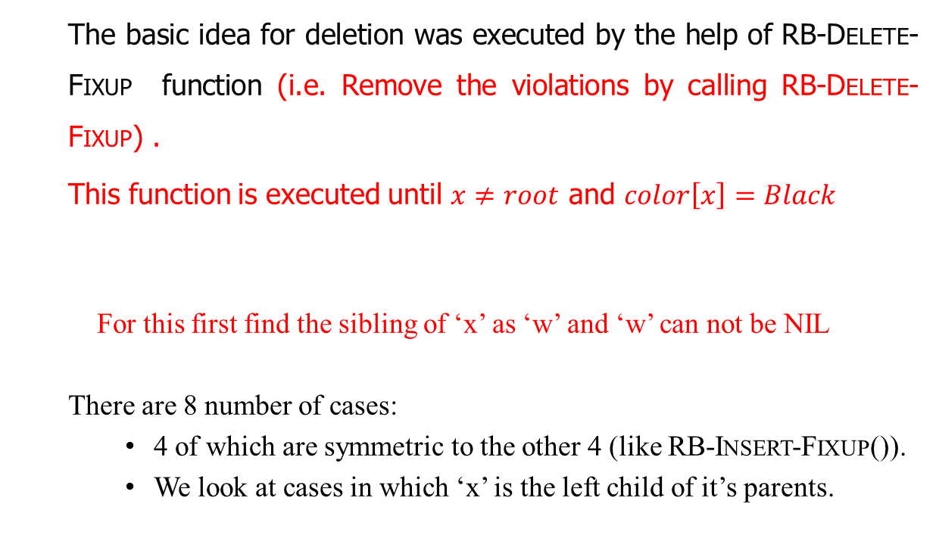
Red Black Tree (Deletion)
The basic idea for deletion was executed by the help of RB-Delete-Fixup function (i.e. Remove the violations by calling RB-Delete-Fixup) .
This function is executed until $x≠root$ and $color\left[x\right]=Black$
For this first find the sibling of ‘x’ as ‘w’ and ‘w’ can not be NIL
There are 8 number of cases:
4 of which are symmetric to the other 4 (like RB-Insert-Fixup()).
We look at cases in which ‘x’ is the left child of it’s parents.

Slide 11
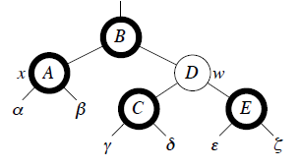
Red Black Tree (Deletion)
Case 1:
When ‘w’(sibling of ’x’ )is red and w=right[p[x]]
Action to be taken
Change the color[w]=Black.
Change the color[p[x]]=Red.
Left_Rotate(T,p[x])
Move w=right[p[x]]
Go immediately to case 2, 3, or 4.
Case 1
[Nodes with bold outline indicate black nodes and light outline indicate red nodes]

Slide 12
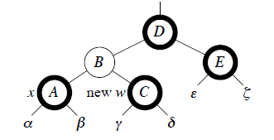
THE STORY
B
X
W

Slide 13
Red Black Tree (Deletion)
Case 1:
When ‘w’(sibling of ’x’ )is red and w=right[p[x]]
Action to be taken
Change the color[w]=Black.
Change the color[p[x]]=Red.
Left_Rotate(T,p[x])
Move w=right[p[x]]
Go immediately to case 2, 3, or 4.
Case 1
[Nodes with bold outline indicate black nodes and light outline indicate red nodes]

Slide 14
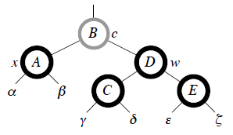
Red Black Tree (Deletion)
Case 2:
When ‘w’(sibling of ’x’ )is black and both the children of of ‘w’ is also black.
Action to be taken
Change color[w]=Red.
Move x=p[x]
Case 2
[Nodes with bold outline indicate black nodes and light outline indicate red nodes]
[Node with gray outline mark ‘c’ represent unknown color (i.e. may be Red or Black)]

Slide 15
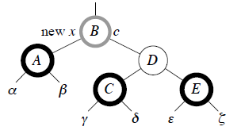
THE STORY
W
X

Slide 16
Red Black Tree (Deletion)
Case 2:
When ‘w’(sibling of ’x’ )is black and both the children of of ‘w’ is also black.
Action to be taken
Change color[w]=Red.
Move x=p[x]
Case 2
[Nodes with bold outline indicate black nodes and light outline indicate red nodes]
[Node with gray outline mark ‘c’ represent unknown color (i.e. may be Red or Black)]

Slide 17
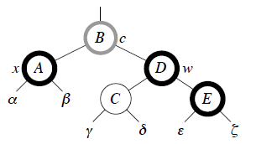
Red Black Tree (Deletion)
Case 3:
When ‘w’(sibling of ’x’ )is black and w’s left child is red and w’s right child is black.
Action to be taken
Color[left[w]]=Black
Color[w]=Red
Right_Rotate(T, w)
Move w=right[p[x]]
Case 3
[Nodes with bold outline indicate black nodes and light outline indicate red nodes]
[Node with gray outline mark ‘c’ represent unknown color (i.e. may be Red or Black)]

Slide 18
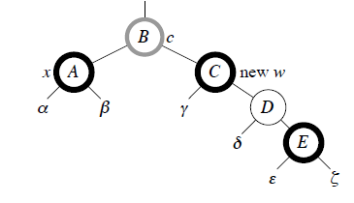
W
X

Slide 19
Red Black Tree (Deletion)
Case 3:
When ‘w’(sibling of ’x’ )is black and w’s left child is red and w’s right child is black.
Action to be taken
Color[left[w]]=Black
Color[w]=Red
Right_Rotate(T, w)
Move w=right[p[x]]
Case 3
[Nodes with bold outline indicate black nodes and light outline indicate red nodes]
[Node with gray outline mark ‘c’ represent unknown color (i.e. may be Red or Black)]

Slide 20
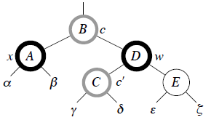
Red Black Tree (Deletion)
Case 4:
When ‘w’(sibling of ’x’ )is black and w’s left child is black and w’s right child is red.
Action to be taken
Color[w]=color[p[x]]
Color[p[x]]=Black
Color[right[w]]=Black
Left_Rotate(T, p[x])
x=root[T]
Case 4
[Nodes with bold outline indicate black nodes and light outline indicate red nodes]
[Node with gray outline mark ‘c’ represent unknown color (i.e. may be Red or Black)]

Slide 21
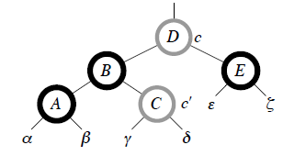
W
X

Slide 22
Red Black Tree (Deletion)
Case 4:
When ‘w’(sibling of ’x’ )is black and w’s left child is black and w’s right child is red.
Action to be taken
Color[w]=color[p[x]]
Color[p[x]]=Black
Color[right[w]]=Black
Left_Rotate(T, p[x])
x=root[T]
Case 4
[Nodes with bold outline indicate black nodes and light outline indicate red nodes]
[Node with gray outline mark ‘c’ represent unknown color (i.e. may be Red or Black)]

Slide 23
Red Black Tree (Deletion)
Case 4:
When ‘w’(sibling of ’x’ )is black and w’s left child is black and w’s right child is red.
Action to be taken
Color[w]=color[p[x]]
Color[p[x]]=Black
Color[right[w]]=Black
Left_Rotate(T, p[x])
x=root[T]
Case 4
[Nodes with bold outline indicate black nodes and light outline indicate red nodes]
[Node with gray outline mark ‘c’ represent unknown color (i.e. may be Red or Black)]

Slide 24
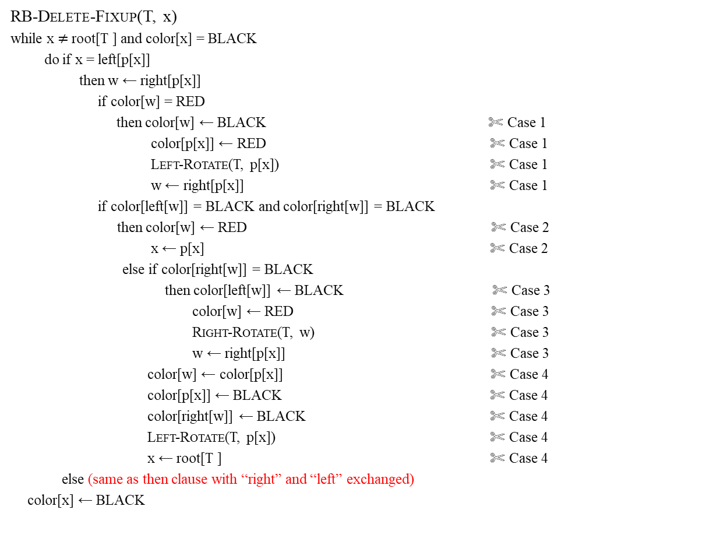
Red Black Tree (Deletion)
RB-Delete-Fixup(T, x)
while x $≠$root[T ] and color[x] = BLACK
do if x = left[p[x]]
then w ← right[p[x]]
if color[w] = RED
then color[w] ← BLACK ✄ Case 1
color[p[x]] ← RED ✄ Case 1
Left-Rotate(T, p[x]) ✄ Case 1
w ← right[p[x]] ✄ Case 1
if color[left[w]] = BLACK and color[right[w]] = BLACK
then color[w] ← RED ✄ Case 2
x ← p[x] ✄ Case 2
else if color[right[w]] = BLACK
then color[left[w]] ← BLACK ✄ Case 3
color[w] ← RED ✄ Case 3
Right-Rotate(T, w) ✄ Case 3
w ← right[p[x]] ✄ Case 3
color[w] ← color[p[x]] ✄ Case 4
color[p[x]] ← BLACK ✄ Case 4
color[right[w]] ← BLACK ✄ Case 4
Left-Rotate(T, p[x]) ✄ Case 4
x ← root[T ] ✄ Case 4
else (same as then clause with “right” and “left” exchanged)
color[x] ← BLACK

Slide 25
Red Black Tree
Insertion (Example 1):
Insert the following elements into an empty RB-Tree.
[ 50, 40, 30, 45, 20, 5]
and then perform delete 40, 20, 30, 45, & 5
Insert -50
50
Aply Fix up
z

Slide 26
Red Black Tree
Insertion (Example 1):
Insert the following elements into an empty RB-Tree.
[ 50, 40, 30, 45, 20, 5]
and then perform delete 40, 20, 30, 45, & 5
Insert -50
50
Apply Fix up
50
z

Slide 27
Red Black Tree
No Fixup required
Insertion (Example 1):
Insert the following elements into an empty RB-Tree.
[ 50, 40, 30, 45, 20, 5]
and then perform delete 40, 20, 30, 45, & 5
Insert -40
50
No Fixup required
40
z

Slide 28
Red Black Tree
No Fixup required
Insertion (Example 1):
Insert the following elements into an empty RB-Tree.
[ 50, 40, 30, 45, 20, 5]
and then perform delete 40, 20, 30, 45, & 5
Insert -30
50
40
NIL
30
z

Slide 29
Red Black Tree
Insertion (Example 1):
Insert the following elements into an empty RB-Tree.
[ 50, 40, 30, 45, 20, 5]
and then perform delete 40, 20, 30, 45, & 5
Insert -30
RR
50
50
Case 3
Fixup Apply
40
NIL
40
NIL
y
y
30
30
After RR
Fixup Apply
40
z
30
50

Slide 30
Red Black Tree
Insertion (Example 1):
Insert the following elements into an empty RB-Tree.
[ 50, 40, 30, 45, 20, 5]
and then perform delete 40, 20, 30, 45, & 5
Insert -45
40
30
50
y
z
45

Slide 31
Red Black Tree
Insertion (Example 1):
Insert the following elements into an empty RB-Tree.
[ 50, 40, 30, 45, 20, 5]
and then perform delete 40, 20, 30, 45, & 5
Insert -45
40
30
50
y
z
45

Slide 32
Red Black Tree
Insertion (Example 1):
Insert the following elements into an empty RB-Tree.
[ 50, 40, 30, 45, 20, 5]
and then perform delete 40, 20, 30, 45, & 5
Insert -45
40
40
Case 1
Fixup Apply
30
50
30
y
y
50
z
45
45
z

Slide 33
Red Black Tree
Insertion (Example 1):
Insert the following elements into an empty RB-Tree.
[ 50, 40, 30, 45, 20, 5]
and then perform delete 40, 20, 30, 45, & 5
Insert -45
40
40
Case 1
40
Fixup Apply
Apply Fix up
30
50
30
y
30
50
50
y
y
z
45
45
z
45
z

Slide 34
Red Black Tree
Insertion (Example 1):
Insert the following elements into an empty RB-Tree.
[ 50, 40, 30, 45, 20, 5]
and then perform delete 40, 20, 30, 45, & 5
Insert -20
40
30
50
z
20
45

Slide 35
Red Black Tree
Insertion (Example 1):
Insert the following elements into an empty RB-Tree.
[ 50, 40, 30, 45, 20, 5]
and then perform delete 40, 20, 30, 45, & 5
Insert -20
40
30
50
No Fixup required
z
20
45

Slide 36
Red Black Tree
Insertion (Example 1):
Insert the following elements into an empty RB-Tree.
[ 50, 40, 30, 45, 20, 5]
and then perform delete 40, 20, 30, 45, & 5
Insert -5
40
30
50
20
45
5
z

Slide 37
Red Black Tree
Insertion (Example 1):
Insert the following elements into an empty RB-Tree.
[ 50, 40, 30, 45, 20, 5]
and then perform delete 40, 20, 30, 45, & 5
Insert -5
40
30
50
20
NIL
45
5
y
z

Slide 38
Red Black Tree
Insertion (Example 1):
Insert the following elements into an empty RB-Tree.
[ 50, 40, 30, 45, 20, 5]
and then perform delete 40, 20, 30, 45, & 5
Insert -5
40
40
Case 3
RR
Fixup Apply
30
50
30
50
20
NIL
45
20
NIL
45
5
y
5
y
z
z

Slide 39
Red Black Tree
Insertion (Example 1):
Insert the following elements into an empty RB-Tree.
[ 50, 40, 30, 45, 20, 5]
and then perform delete 40, 20, 30, 45, & 5
Insert -5
40
40
Case 3
RR
Fixup Apply
30
50
30
50
20
NIL
45
20
NIL
45
After RR
Fixup Apply
5
y
5
y
z
z

Slide 40
Red Black Tree
Insertion (Example 1):
Insert the following elements into an empty RB-Tree.
[ 50, 40, 30, 45, 20, 5]
and then perform delete 40, 20, 30, 45, & 5
Insert -5
40
40
Case 3
RR
Fixup Apply
30
50
30
50
20
NIL
45
20
NIL
45
After RR
Fixup Apply
5
y
5
y
40
z
z
20
50
5
30
45
z

Slide 41
Red Black Tree
Insertion (Example 1):
Insert the following elements into an empty RB-Tree.
[ 50, 40, 30, 45, 20, 5]
and then perform delete 40, 20, 30, 45, & 5
After the Insertion the tree finally looks as shown above.
Now we perform Deletion on RB Tree.
40
20
50
5
30
45

Slide 42
Red Black Tree
Insertion (Example 1):
Insert the following elements into an empty RB-Tree.
[ 50, 40, 30, 45, 20, 5]
and then perform delete 40, 20, 30, 45, & 5
Delete -40
z
40
20
50
5
30
45

Slide 43
Red Black Tree
Insertion (Example 1):
Insert the following elements into an empty RB-Tree.
[ 50, 40, 30, 45, 20, 5]
and then perform delete 40, 20, 30, 45, & 5
Delete -40
40
z
40
z
Find successor y
20
20
50
50
5
5
30
45
30
45
y

Slide 44
Red Black Tree
Insertion (Example 1):
Insert the following elements into an empty RB-Tree.
[ 50, 40, 30, 45, 20, 5]
and then perform delete 40, 20, 30, 45, & 5
Delete -40
z
40
z
40
Find successor y
20
50
Check y has one or no child
20
50
5
30
45
5
30
45
y

Slide 45
Red Black Tree
Insertion (Example 1):
Insert the following elements into an empty RB-Tree.
[ 50, 40, 30, 45, 20, 5]
and then perform delete 40, 20, 30, 45, & 5
Delete -40
40
z
40
z
Find successor y
20
20
50
Check y has one or no child
50
5
5
30
45
30
45
y
If y has no child and then simply exchange the key of y with key of z and delete y

Slide 46
Red Black Tree
Insertion (Example 1):
Insert the following elements into an empty RB-Tree.
[ 50, 40, 30, 45, 20, 5]
and then perform delete 40, 20, 30, 45, & 5
Delete -40
40
z
40
z
Find successor y
20
Check y has one or no child
50
20
50
5
30
45
5
30
45
y
45
If y has no child then simply exchange the key of y with key of z and delete y
20
50
5
30
y

Slide 47
Red Black Tree
Insertion (Example 1):
Insert the following elements into an empty RB-Tree.
[ 50, 40, 30, 45, 20, 5]
and then perform delete 40, 20, 30, 45, & 5
Delete -20
45
z
20
50
5
30

Slide 48
Red Black Tree
Insertion (Example 1):
Insert the following elements into an empty RB-Tree.
[ 50, 40, 30, 45, 20, 5]
and then perform delete 40, 20, 30, 45, & 5
Delete -20
45
Find successor y
45
z
z
20
50
20
50
5
30
5
30
y

Slide 49
Red Black Tree
Insertion (Example 1):
Insert the following elements into an empty RB-Tree.
[ 50, 40, 30, 45, 20, 5]
and then perform delete 40, 20, 30, 45, & 5
Delete -20
45
Find successor y
45
z
z
20
50
20
50
Check y has one or no child
5
30
5
30
y

Slide 50
Red Black Tree
Insertion (Example 1):
Insert the following elements into an empty RB-Tree.
[ 50, 40, 30, 45, 20, 5]
and then perform delete 40, 20, 30, 45, & 5
Delete -20
45
Find successor y
45
z
z
20
50
20
50
Check y has one or no child
5
30
5
30
y
If y has no child and then simply exchange the key of y with key of z and delete y

Slide 51
Red Black Tree
Insertion (Example 1):
Insert the following elements into an empty RB-Tree.
[ 50, 40, 30, 45, 20, 5]
and then perform delete 40, 20, 30, 45, & 5
Delete -20
45
45
z
Find successor y
z
20
50
20
50
Check y has one or no child
5
30
y
5
30
45
If y has no child and then simply exchange the key of y with key of z and delete y
z
30
50
5

Slide 52
Red Black Tree
Insertion (Example 1):
Insert the following elements into an empty RB-Tree.
[ 50, 40, 30, 45, 20, 5]
and then perform delete 40, 20, 30, 45, & 5
Delete -30
45
z
Find successor y
30
50
5

Slide 53
Red Black Tree
Insertion (Example 1):
Insert the following elements into an empty RB-Tree.
[ 50, 40, 30, 45, 20, 5]
and then perform delete 40, 20, 30, 45, & 5
Delete -30
45
No successor, Hence y=z and x=right[y]
z
Find successor y
30
50
5

Slide 54
Red Black Tree
Insertion (Example 1):
Insert the following elements into an empty RB-Tree.
[ 50, 40, 30, 45, 20, 5]
and then perform delete 40, 20, 30, 45, & 5
Delete -30
No successor, Hence y=z and x=right[y]
45
z
Find successor y
45
30
50
z
30
50
5
x
y
5

Slide 55
Red Black Tree
Insertion (Example 1):
Insert the following elements into an empty RB-Tree.
[ 50, 40, 30, 45, 20, 5]
and then perform delete 40, 20, 30, 45, & 5
Delete -30
No successor, Hence y=z and x=right[y]
45
z
Find successor y
45
30
50
z
30
50
5
x
y
5
P[x]=p[y] and
Left[p[y]]=x

Slide 56
Red Black Tree
Insertion (Example 1):
Insert the following elements into an empty RB-Tree.
[ 50, 40, 30, 45, 20, 5]
and then perform delete 40, 20, 30, 45, & 5
Delete -30
No successor, Hence y=z and x=right[y]
45
z
Find successor y
45
30
50
z
30
50
5
x
y
45
5
P[x]=p[y] and
Left[p[y]]=x
x
5
50

Slide 57
Red Black Tree
Insertion (Example 1):
Insert the following elements into an empty RB-Tree.
[ 50, 40, 30, 45, 20, 5]
and then perform delete 40, 20, 30, 45, & 5
Delete -30
No successor, Hence y=z and x=right[y]
45
z
Find successor y
45
30
50
z
30
50
5
x
y
45
5
P[x]=p[y] and
Left[p[y]]=x
x
5
50
Call Fixup

Slide 58
Red Black Tree
Insertion (Example 1):
Insert the following elements into an empty RB-Tree.
[ 50, 40, 30, 45, 20, 5]
and then perform delete 40, 20, 30, 45, & 5
Delete -30
45
It was found that it was not enter inside the while loop, so execute the last line of RB-Delete-Fixup,(i.e. color[x]=Black
x
5
50

Slide 59
Red Black Tree
Insertion (Example 1):
Insert the following elements into an empty RB-Tree.
[ 50, 40, 30, 45, 20, 5]
and then perform delete 40, 20, 30, 45, & 5
Delete -30
45
It was found that it was not enter inside the while loop, so execute the last line of RB-Delete-Fixup,(i.e. color[x]=Black
x
5
50
45
x
5
50

Slide 60
Red Black Tree
Insertion (Example 1):
Insert the following elements into an empty RB-Tree.
[ 50, 40, 30, 45, 20, 5]
and then perform delete 40, 20, 30, 45, & 5
Delete -40
z
45
5
50

Slide 61
Red Black Tree
Insertion (Example 1):
Insert the following elements into an empty RB-Tree.
[ 50, 40, 30, 45, 20, 5]
and then perform delete 40, 20, 30, 45, & 5
Delete -40
z
45
Find successor y
5
50

Slide 62
Red Black Tree
Insertion (Example 1):
Insert the following elements into an empty RB-Tree.
[ 50, 40, 30, 45, 20, 5]
and then perform delete 40, 20, 30, 45, & 5
Delete -40
z
45
z
45
Find successor y
5
50
5
50
y

Slide 63
Red Black Tree
Insertion (Example 1):
Insert the following elements into an empty RB-Tree.
[ 50, 40, 30, 45, 20, 5]
and then perform delete 40, 20, 30, 45, & 5
Delete -40
If y has no child and then simply exchange the key of y with key of z and delete y
z
45
z
45
Find successor y
5
50
5
50
y

Slide 64
Red Black Tree
Insertion (Example 1):
Insert the following elements into an empty RB-Tree.
[ 50, 40, 30, 45, 20, 5]
and then perform delete 40, 20, 30, 45, & 5
Delete -40
If y has no child and then simply exchange the key of y with key of z and delete y
z
45
z
45
Find successor y
5
50
5
50
y
z
50
5
x
NIL

Slide 65
Red Black Tree
Insertion (Example 1):
Insert the following elements into an empty RB-Tree.
[ 50, 40, 30, 45, 20, 5]
and then perform delete 40, 20, 30, 45, & 5
Delete -40
If y has no child and then simply exchange the key of y with key of z and delete y
z
45
z
45
Find successor y
5
50
5
50
y
RB-Tree property is disturb , so Call Fixup
z
50
5
x
NIL

Slide 66
Red Black Tree
Insertion (Example 1):
Insert the following elements into an empty RB-Tree.
[ 50, 40, 30, 45, 20, 5]
and then perform delete 40, 20, 30, 45, & 5
Delete -40
If y has no child and then simply exchange the key of y with key of z and delete y
z
45
z
45
Find successor y
5
50
5
50
y
RB-Tree property is disturb , so Call Fixup
z
50
Find sibling w
5
x
NIL

Slide 67
Red Black Tree
Insertion (Example 1):
Insert the following elements into an empty RB-Tree.
[ 50, 40, 30, 45, 20, 5]
and then perform delete 40, 20, 30, 45, & 5
Delete -40
If y has no child and then simply exchange the key of y with key of z and delete y
z
45
z
45
Find successor y
5
50
5
50
y
RB-Tree property is disturb , so Call Fixup
z
50
Find sibling w
z
50
w
5
x
NIL
5
x
NIL

Slide 68
Red Black Tree
Insertion (Example 1):
Insert the following elements into an empty RB-Tree.
[ 50, 40, 30, 45, 20, 5]
and then perform delete 40, 20, 30, 45, & 5
Delete -40
z
50
Apply Fixup Case 2
w
x
5
NIL

Slide 69
Red Black Tree
Insertion (Example 1):
Insert the following elements into an empty RB-Tree.
[ 50, 40, 30, 45, 20, 5]
and then perform delete 40, 20, 30, 45, & 5
Delete -40
z
50
z
50
Apply Fixup Case 2
w
x
w
5
NIL
5

Slide 70
Red Black Tree
Insertion (Example 1):
Insert the following elements into an empty RB-Tree.
[ 50, 40, 30, 45, 20, 5]
and then perform delete 40, 20, 30, 45, & 5
Delete -5
50
z
5

Slide 71
Red Black Tree
Insertion (Example 1):
Insert the following elements into an empty RB-Tree.
[ 50, 40, 30, 45, 20, 5]
and then perform delete 40, 20, 30, 45, & 5
Delete -5
50
Find successor y
z
5

Slide 72
Red Black Tree
Insertion (Example 1):
Insert the following elements into an empty RB-Tree.
[ 50, 40, 30, 45, 20, 5]
and then perform delete 40, 20, 30, 45, & 5
Delete -5
50
50
Find successor y
z
z
5
5
y

Slide 73
Red Black Tree
Insertion (Example 1):
Insert the following elements into an empty RB-Tree.
[ 50, 40, 30, 45, 20, 5]
and then perform delete 40, 20, 30, 45, & 5
Delete -5
If y has no child and then simply exchange the key of y with key of z and delete y
50
50
Find successor y
z
z
5
5
y
Final Tree
50

Slide 74

Thank U

